Slide 1

Strategy In Motion: Choices that define Giants

Slide 2
Your first Mission: To See the game
Every major corporation you know exists because of strategic choices.
These aren't just decisions; they are gambles, pivots, expansions, and retrenchments.
In this course, we will learn to identify these choices, analyze their impact, and ultimately, advise on the next ones.

Slide 3
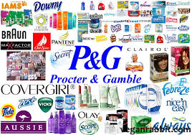
P&G
Why would a company like P&G Sell successful brands like Folgers Coffee and Pringles?
What’s the strategic rationale behind shrinking the company size?
What are the risks of such a move? What are the benefits

Slide 4
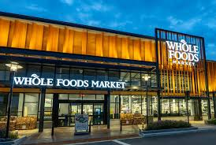
Amazon’s Strategic pivot to “Everything Store”
What’s Amazon core strategy?
What do its expansions into seemingly unadjacent categories tell us about their strategic ambitions?
Why are they playing in these areas?

Slide 5
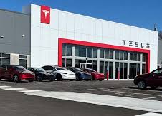
Tesla: Disrupting the Incumbents
Why did Tesla choose to avoid the traditional dealership model? What strategic advantages did this give them?
How has this choice impacted the legacy automative companies? What did they have in response?

Slide 6
The Consultant's Eye: Seeing the Future, Advising the Present
These companies didn't get where they are by accident. They made choices.
They navigated global forces, intense competition, and internal challenges.
Your role as a strategy consultant is to help leaders make these choices.
It requires insight, foresight, and the courage to challenge assumptions.

Slide 7
Agenda
1. Master the rules
2. Leadership economics
3. Profit pools shift
4. Customer focus
5. Execution

Slide 8
Introduction
Turbulence persists but fundamentals endure.
Only ~10% of firms sustain long-term value creation.

Slide 9
Lesson 1: Master the Rules
Define the business correctly.
Avoid too narrow or too broad definitions.
Reassess as markets evolve.

Slide 10
Lesson 2: Leadership Economics
Leaders capture most economic profit.
Aim for leadership or differentiate sharply.
Avoid complacency.

Slide 11
Lesson 3: Profit Pools Shift
Map current and future profit pools.
Act before shifts happen.
Balance no-regrets moves and bets.

Slide 12
Lesson 4: Customer Focus
Understand segments and drivers.
Identify high-profit customers.
Build customer intimacy as you scale.

Slide 13
Lesson 5: Strategy = Action
Execution is integral.
Speed and pilots enable learning.
Design operating model to deliver.

Slide 14
Summary & Implications
Coherent framework linking 5 beliefs.
Review business definition, profit pools, customers, execution.

